Slide 1
C♯ The Gilded Rose
Rasmus Lystrøm
Associate Professor
ITU
rnie@itu.dk

Slide 2

Agenda
Refactoring kata
The Gilded Rose
Pointers
Code Coverage
Resources

Slide 3
Refactoring kata
Kata: Japanese word, literally meaning “form”.
~ any basic form, routine, or pattern of behavior that is practiced to various levels of mastery
Practice makes perfect

Slide 4
Gilded Rose background
Hi and welcome to team Gilded Rose. As you know, we are a small inn with a prime location in a prominent city ran by a friendly innkeeper named Allison. We also buy and sell only the finest goods.
Unfortunately, our goods are constantly degrading in quality as they approach their sell by date.
We have a system in place that updates our inventory for us. It was developed by a no-nonsense type named Leeroy, who has moved on to new adventures.
Your task is to add the new feature to our system so that we can begin selling a new category of items. First an introduction to our system:

Slide 5
Gilded Rose specification
All items have a SellIn value which denotes the number of days we have to sell the item
All items have a Quality value which denotes how valuable the item is
At the end of each day our system lowers both values for every item
Pretty simple, right? Well this is where it gets interesting:
Once the sell by date has passed, Quality degrades twice as fast
The Quality of an item is never negative
"Aged Brie" actually increases in Quality the older it gets
The Quality of an item is never more than 50
"Sulfuras", being a legendary item, never has to be sold or decreases in Quality
"Backstage passes", like aged brie, increases in Quality as it's SellIn value approaches; Quality increases by 2 when there are 10 days or less and by 3 when there are 5 days or less but Quality drops to 0 after the concert
We have recently signed a supplier of conjured items. This requires an update to our system:
- "Conjured" items degrade in Quality twice as fast as normal items

Slide 6
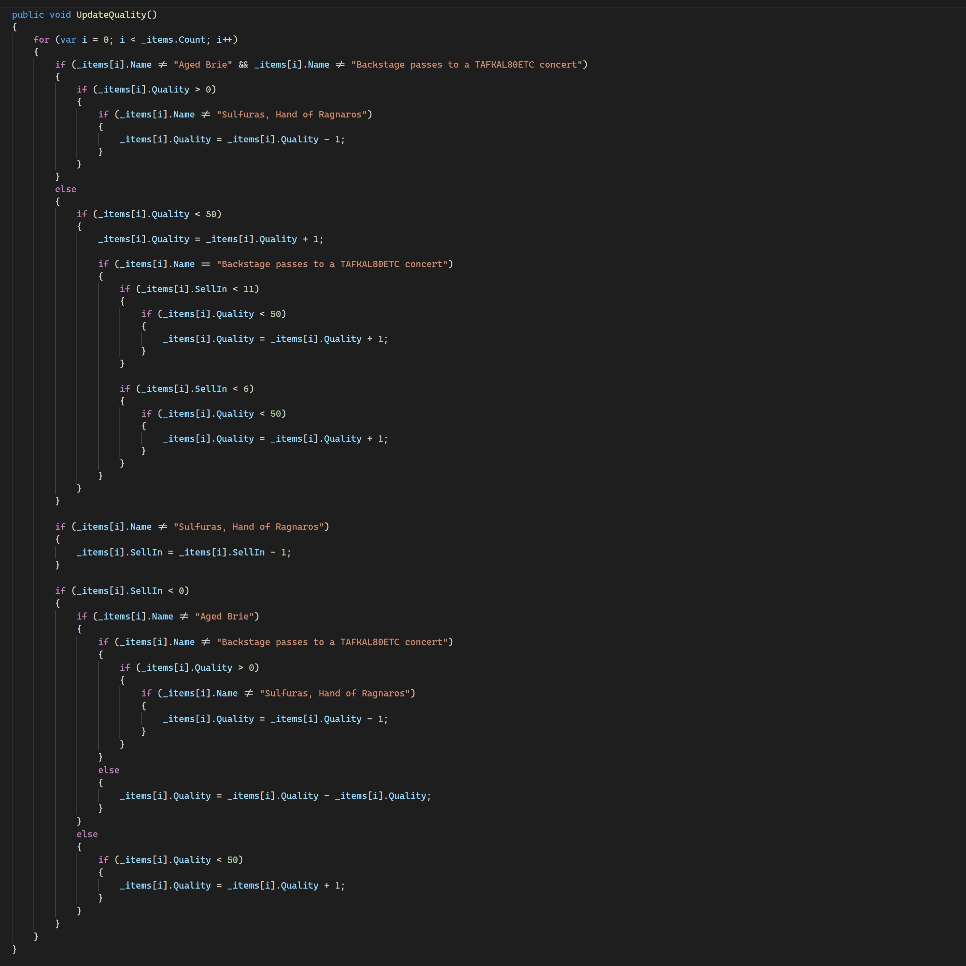
Implement “Conjured”

Slide 7
“make the change easy (warning: this may be hard), then make the easy change”
Kent Beck, 2012

Slide 8
Refactoring
But first: MAKE THEN CHANGE SAFE!
Ensure 100% code coverage in GildedRose.cs
Test Main to verify that in generates the same output
(dotnet run > output.txt)
Now fix!
Extract method → Polymorphism

Slide 9
Code Coverage
dotnet add package coverlet.collector
dotnet add package coverlet.msbuild
dotnet test /p:CollectCoverage=true
+-----------------------+------+--------+--------+
| Module | Line | Branch | Method |
+-----------------------+------+--------+--------+
| GildedRose | 0% | 0% | 0% |
+-----------------------+------+--------+--------+

Slide 10
.NET Watcher
From the tests folder:
dotnet watch test /p:CollectCoverage=true

Slide 11
Resources
Martin Fowler on Refactoring: https://martinfowler.com/articles/preparatory-refactoring-example.html
Sandy Metz on solving the Guilded Rose in Ruby: https://youtu.be/8bZh5LMaSmE
The original Gilded Rose by Terry Hughes and Bobby Johnson: https://github.com/NotMyself/GildedRose
More katas: https://kata-log.rocks/

